Slide 1
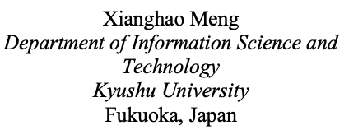
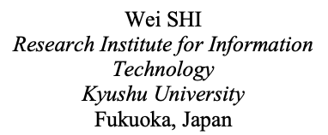
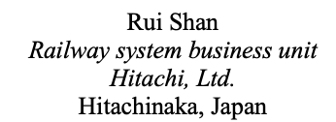
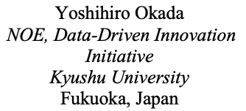
An Obstacle Avoidance System for Visual Impaired People Based on Object Tracking Algorithm and Semantic Segmentation

Slide 2
Contents
Introduction
Related research
Related work: Enabling technology
System construction
Experiment & Discussion
Conclusion

Slide 3
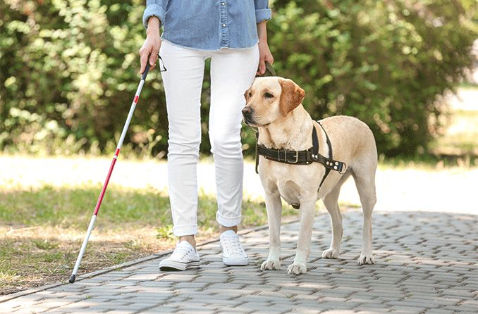
1. Introduction
Visually impaired individuals face difficulties in perceiving their surroundings, identifying obstacles, and avoiding collisions.
Traditional mobility aids, such as white canes and guide dogs, have limitations.
White canes are limited to stationary obstacles within its reach and provide no information about moving objects or hazards outside its range.
Guide dogs are expensive to train and maintain, and the demand for them far exceeds the supply.
Notes:
Visually impaired individuals face difficulties in perceiving their surroundings and avoiding collisions. Traditional mobility aids, such as white canes and guide dogs, have limitations. White canes are limited to stationary obstacles within its reach, while guide dogs are expensive to train and maintain. The ability to move safely and independently is crucial for their quality of life.

Slide 4
1. Introduction
Computer vision and machine learning have enabled sophisticated assistive devices
Multiple Object Tracking technology can detect and track multiple objects in real-time
Provides valuable information for visually impaired individuals to navigate safely
Semantic segmentation algorithms can classify and segment the environment
Provides detailed understanding of surroundings
Considering the above, the primary objective of this research is to develop an advanced navigation system for visually impaired individuals by integrating Multiple Object Tracking and Semantic segmentation for avoiding obstacles or stepping off the sidewalk.
Notes:
Technological advancements in computer vision and machine learning have enabled the development of sophisticated assistive devices. Multiple Object Tracking technology can detect and track multiple objects in real-time, providing valuable information for visually impaired individuals to navigate safely. However, existing solutions have limitations such as latency and inability to accurately detect road elements.

Slide 5
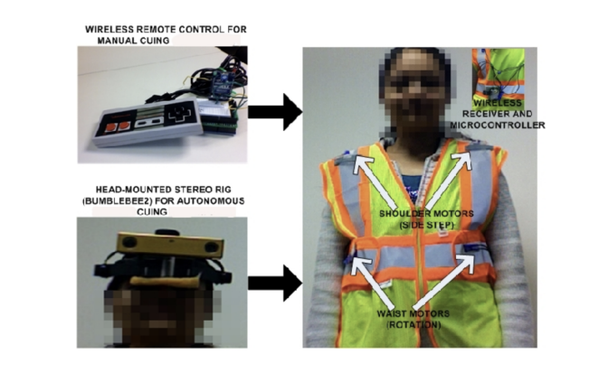
2. Related research
Pradeep et al. (2019): Robot Vision for the Visually Impaired
A robot vision system for assisting visually impaired individuals
Mobile robots equipped with cameras and computer vision algorithms
Recognizes objects and provides navigational assistance through audio feedback
Strengths
Mobile platform allows for dynamic navigation and real-time assistance
Advanced object recognition
Intuitive audio feedback
Limitations
Dependency on mobile robots can limit flexibility and portability
Regular maintenance required
Effectiveness can be compromised in varying environments
Notes:
Pradeep et al. developed a robot vision system for assisting visually impaired individuals. The system uses mobile robots equipped with cameras and computer vision algorithms to recognize objects and provide navigational assistance through audio feedback. The system has strengths such as its mobile platform and advanced object recognition, but also has limitations such as its dependency on mobile robots and potential reliability issues.

Slide 6
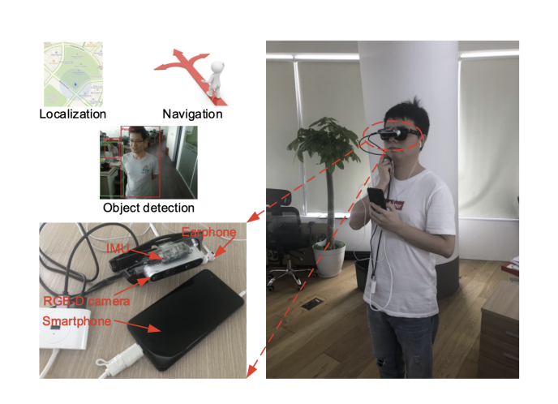
2. Related research
Bai et al. (2019): Wearable Travel Aid for Environment Perception and Navigation
Strengths
Wearable design for portability and convenience
Multi-modal feedback for intuitive guidance
Advanced machine learning algorithms for accuracy
Limitations
Short battery life requiring frequent recharging
Limited processing power affecting performance
Performance influenced by environmental factors
Notes:
Bai et al. developed a wearable travel aid for visually impaired individuals. It uses cameras, sensors, and machine learning algorithms to provide audio and haptic feedback. The system has strengths such as its wearable design, multi-modal feedback, and advanced algorithms. However, it also has limitations such as short battery life, limited processing power, and environmental constraints.

Slide 7
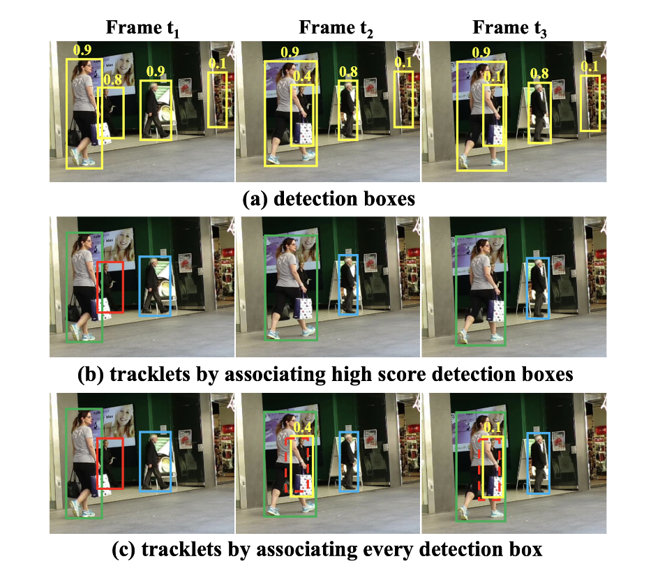
3. Related work: Enabling technology
3.1 ByteTrack: Multi-Object Tracking by Associating Every Detection Box
Detection
Uses high-performance object detector such as YOLOX
Outputs bounding boxes with confidence scores
Embedding Extraction
Extracts embeddings using a deep neural network
Uses a separate embedding model for high-quality feature extraction
Data Association
Two-stage process to link detections across frames
First stage matches high-confidence detections to existing tracklets
Second stage matches low-confidence detections to unmatched tracklets
Notes:
ByteTrack is a robust and efficient Multiple Object Tracking algorithm designed to handle real-world tracking challenges. It enhances traditional MOT algorithms by associating every detection box, including low confidence scores. This significantly improves tracking performance by reducing missed detections and maintaining object identities even in complex scenarios.

Slide 8
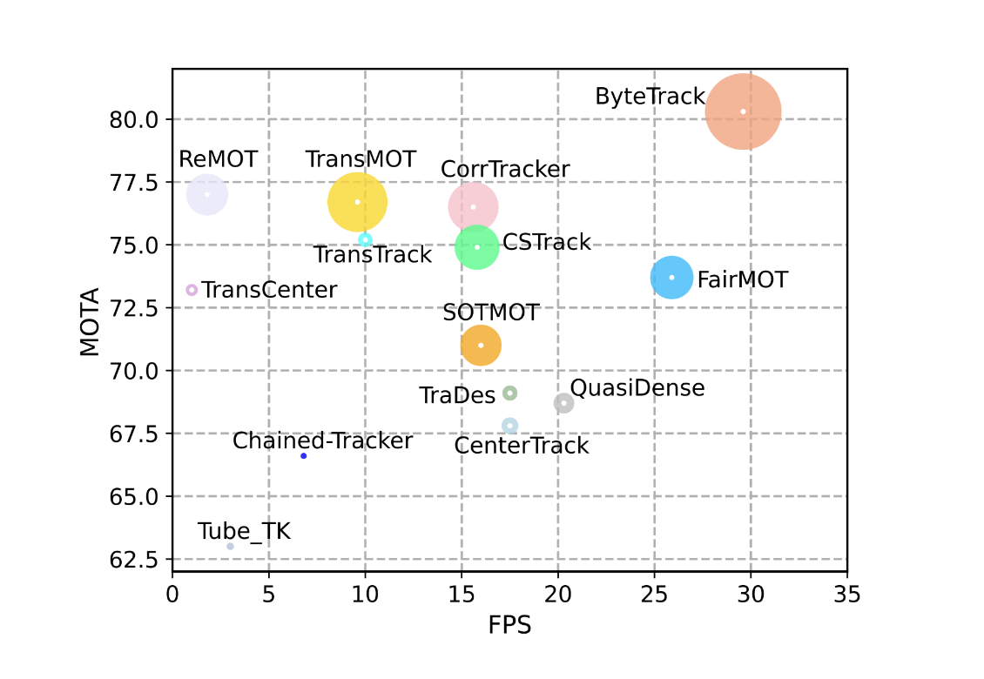
3. Related work: Enabling technology
3.1 ByteTrack: Multi-Object Tracking by Associating Every Detection Box
ByteTrack outperforms FairMOT with both higher MOTA（Multi-Object Tracking Accuracy） and FPS, implying that it offers superior accuracy with lower latency, making it a comprehensive improvement over FairMOT.
After importing pretrained models and custom training on our dataset, we successfully achieved vehicle object detection（bicycles and cars etc.)
In addition, we attained higher accuracy and faster detection speed compared to FairMOT.
Notes:
ByteTrack uses pre-trained models for detection and embedding extraction. During inference, it processes each video frame sequentially, generating bounding boxes and extracting appearance features. It is evaluated using standard MOT benchmarks and achieves state-of-the-art results.

Slide 9
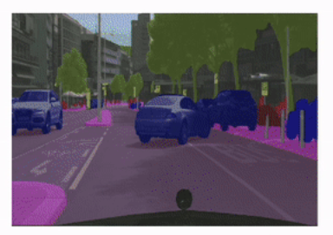
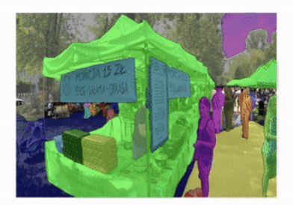
3. Related work: Enabling technology
3.2 MMSegmentation: Open-source semantic segmentation toolbox based on PyTorch
Semantic segmentation: pixel-wise classification
Classifies each pixel into predefined categories
Provides detailed understanding of environment
Essential for obstacle avoidance systems
Model Architecture
mmsegmentation supports various state-of-the-art segmentation models
Data Preparation
Training process requires a well-annotated dataset with pixel-wise labels
Notes:
mmsegmentation is an open-source toolbox for semantic segmentation, developed by the OpenMMLab team. It supports a wide range of algorithms and offers extensive customization options. Semantic segmentation involves classifying each pixel into predefined categories, providing a detailed understanding of the environment.
This slide covers the details of the algorithm used for image segmentation. It includes information on the model architecture, data preparation, training procedure, and inference process. The HRNet model was selected for its high accuracy and efficiency, and the Cityscapes dataset was utilized for training. The training procedure involves a customized pipeline with data augmentation techniques, and the final output is a segmented image with pixel-wise labels.

Slide 10
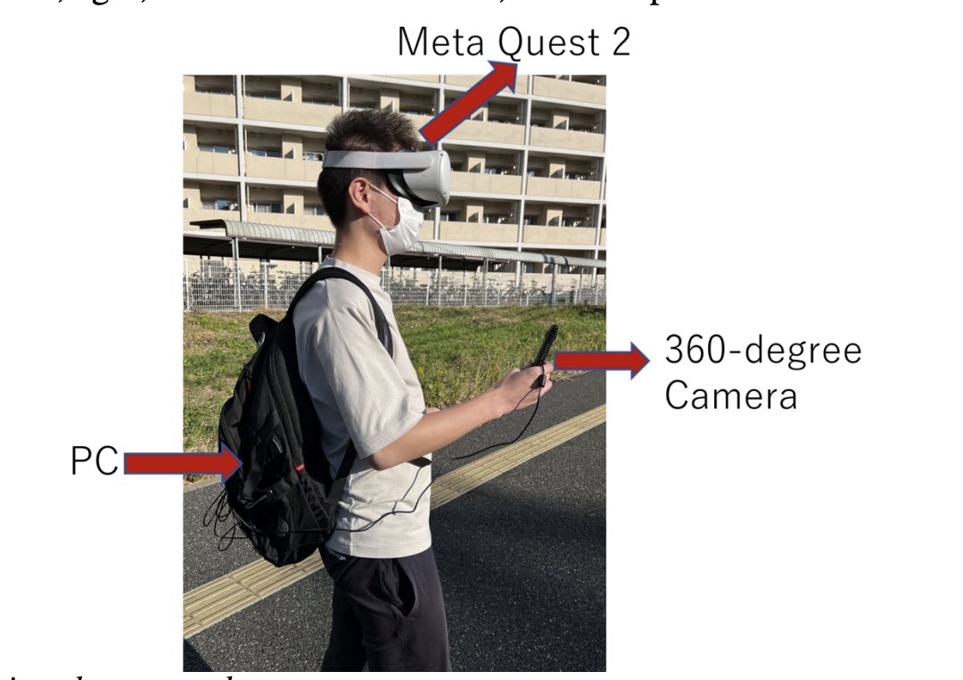
4. System construction
4.1 Shan Rui et al. (2023) : A Pedestrian Avoidance System for Visual Impaired People Based on Object Tracking Algorithm
Input Component
Uses RICOH R Development Kit 360-degree camera
Provides comprehensive view of user's surroundings
Data Processing Component
Uses FairMOT algorithm for object detection and re-identification
Built on top of CenterNet framework
Processes video feed to detect and track pedestrians
Output Component
Uses Meta Quest 2 VR headset to deliver feedback
Provides audio, visual, and haptic signals
Integrated with WebVR application for immersive experience
Notes:
The pedestrian avoidance system developed by Shan Rui et al. is designed to help visually impaired individuals navigate their environment safely by detecting and tracking pedestrians around them. The system uses a combination of a 360-degree camera, a VR headset, and advanced object tracking algorithms to provide real-time feedback to the user.
Shan Rui et al. conducted experiments to evaluate their system's performance. The average latency was found to be approximately 650.1 milliseconds. The system demonstrated high accuracy in most scenarios. User feedback was gathered through field testing, and participants found the system helpful in avoiding collisions.

Slide 11
4. System construction
4.1 Shan Rui et al. (2023) : A Pedestrian Avoidance System for Visual Impaired People Based on Object Tracking Algorithm
Strengths
Comprehensive View: 360-degree camera provides complete view of environment
Real-Time Feedback: System delivers real-time feedback through VR headset
Object Tracking: Integration of FairMOT allows effective tracking of multiple pedestrians
Platform Accessibility: Use of WebVR technology for access on multiple platforms
Limitations
High Latency: System experiences latency in fast-changing environments
Limited Detection Scope: System primarily focuses on pedestrian detection
Lack of Semantic Segmentation: System does not incorporate semantic segmentation
Notes:
The system has several strengths, including a comprehensive view, real-time feedback, object tracking, multi-modal feedback, and platform accessibility. However, it also has limitations, such as high latency, limited detection scope, lack of semantic segmentation, device dependency, and false positives. These limitations can be addressed in future improvements.

Slide 12
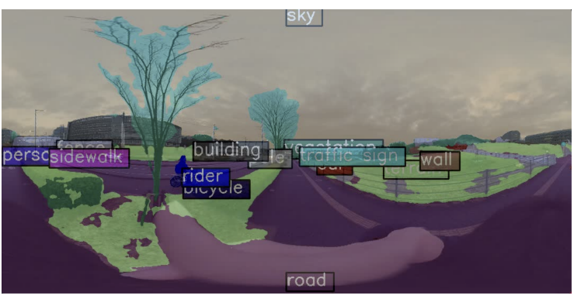
4. System construction
4.2 Our Update System
Integration of ByteTrack and mmsegmentation
Dataset for mmsegmentation: Cityscapes dataset was utilized
Model for mmsegmentation: HRNet (High-Resolution Net) chosen for high accuracy and efficiency Segmentation
RTX 3070ti and RTX 2060：Distributes computational load across multiple GPUs
Notes:
HRNet的注释说明：HRNet, or High-Resolution Net, is a general purpose convolutional neural network for tasks like semantic segmentation, object detection and image classification.
Integration of ByteTrack and mmsegmentation The integration of ByteTrack and mmsegmentation is a key innovation in our system. ByteTrack enhances multiple object tracking by associating every detection box, including those with low confidence scores, which are typically discarded by other methods. This approach significantly improves tracking performance by reducing missed detections and maintaining object identities even in complex scenarios.
mmsegmentation, on the other hand, provides a comprehensive understanding of the environment through pixel-wise classification. It supports various state-of-the-art segmentation models, including HRNet, which is chosen for its high accuracy and efficiency. HRNet maintains high-resolution representations throughout the network, enabling precise segmentation of fine details and complex structures.

Slide 13
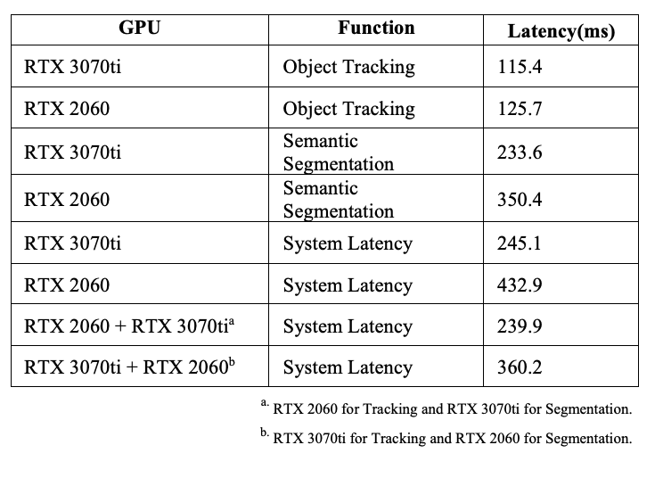
5. Experiment & Discussion
We conducted several experiments to evaluate the system’s performance in various scenarios.
Goal: Reduce system latency to ensure timely feedback for visually impaired users navigating dynamic environments.
Key Improvements:
Latency reduced to approximately 60 milliseconds.
Parallel GPU processing proved effective in enhancing system responsiveness.
Semantic Segmentation Impact:
More resource-intensive, increasing latency.
But RTX 3070ti is sufficient for handling both tasks with minimal latency increase.
Challenges:
PC Requirement: Users currently need to carry a PC for local data processing due to the cloud latency challenge.
Cloud Processing Exploration: Replacing the RICOH R camera with Insta360 X3 led to video transmission latency exceeding 5 seconds.
Notes:
先说明整个表格，RTX 3070ti + RTX 2060 means using RTX 3070ti for Object Tracking and RTX 2060 for Semantic Segmentation. RTX 2060 + RTX 3070ti is the opposite.
In this research, we developed an advanced obstacle avoidance system for visually impaired individuals. We utilized ByteTrack for improved object tracking and mmsegmentation for detailed environmental understanding. We also implemented multi-GPU processing for real-time performance. Our system provides real-time, comprehensive feedback to users for safe navigation in dynamic environments.
As shown in Table I, semantic segmentation consumes more system resources and significantly increases latency. When a single GPU is used for both object tracking and semantic segmentation, the system’s latency increases. However, with parallel computing technology, the latency is nearly equal to that of performing only semantic segmentation. The results also indicate that an RTX 3070ti GPU is sufficient for handling both object tracking and semantic segmentation simultaneously without a substantial increase in latency. These findings can inform the configuration of cloud servers in future iterations.

Slide 14
6. Conclusion
Currently we have accomplished：
The updated system successfully integrates ByteTrack and MMSegmentation, providing real-time, accurate feedback for visually impaired users.
The focus on reducing latency through multi-GPU processing is crucial for improving real-time performance.
The system offers a significant advancement in assistive technology, enhancing safety and independence.
Future work：
Cloud Optimization: Addressing latency challenges for remote data processing.
Map Integration: Add route navigation to ensure safer paths.
Environmental Robustness: Improve system performance under varying lighting and environmental conditions.

Slide 15
Reference
World Health Organization. (2014). Visual Impairment and Blindness. Retrieved from: https://www.who.int/news-room/fact-sheets/detail/ blindness-and-visual-impairment
Pradeep, N., Medioni, G., & Weiland, J. D. (2019). Robot Vision for the Visually Impaired. Computer Vision and Image Understanding, 178, 2-13.
Bai, J., Liu, Z., Lin, Y., Li, Y., Lian, S., & Liu, D. (2019). Wearable Travel Aid for Environment Perception and Navigation of Visually Impaired People. Electronics, 8 (6), 697.
Shi, W., Shan, R., & Okada, Y. (2022). A Navigation System for Visual Impaired People Based on Object Detection. 12th International Congress on Advanced Applied Informatics (IIAI-AAI).
Shan, R., Shi, W., Teng, Z., & Okada, Y. (2023). A Pedestrian Avoidance System for Visual Impaired People Based on Object Tracking Algorithm. In Advances in Internet Data & Web Technologies: The 11th International Conference on Emerging Internet Data & Web Technologies (EIDWT-2023) (pp. 375-385).

Slide 16
Thank you for listening！
MENG XIANGHAO
2024.11.4

